Slide 1


Kithul Treacle and Kithul jaggery Maker
Group No:18

Slide 2




Group Members
 | Name | Reg. No: | Photo
Group Leader | KAPUWATHTHA HBMRMM | 205050U
Member 1 | SALAMA FHF | 205093D
Member 2 | THENNAKOON TMMS | 205108G
Member 3 | SAMARAKKODY SATS | 205096N

Slide 3
Outline
Problem In Brief
Project Aim & Objectives
Proposed Solution
Design
3D Diagram
Resources Required
Cost Estimation
Test & Implementation
Individual Contribution

Slide 4
Problem in brief
Using the traditional method to produce Kithul Treacle and Kithul Jaggery. (Woodfire)
When Sap of the Kithul Flower is heated, the wood fire should be controlled on the same level.
Sap of the Kithul Flower mixture should be mixed until the end of the process.
Producers must stay near the heating Sap of the Kithul Flower mixture and pay attention all the time.
Since producers must stay near wood fires there is a risk and higher chance of getting skin burns.
Producer should have the best understanding of the level of thickness for making Treacle and Jaggery.
Producers have to spend more time and energy.

Slide 5





Problem in brief

Slide 6
Aim
Our aim is to design and develop an automated machine to produce a Kithul Treacle and Kithul Jaggery machine for domestic usage

Slide 7
Our objectives
To overcome the limitations of traditional methods.
To bring an innovative Kithul Treacle and Jaggery making machine to the market.
To reduce the time and energy wastage of users.
To meet customer’s expectations by providing well-performing, easy to operate the machine
To easily operate the Kithul Treacle and Jaggery-making machine simply with a keypad.
To let anyone make Kithul Treacle and Jaggery at home easily.

Slide 8
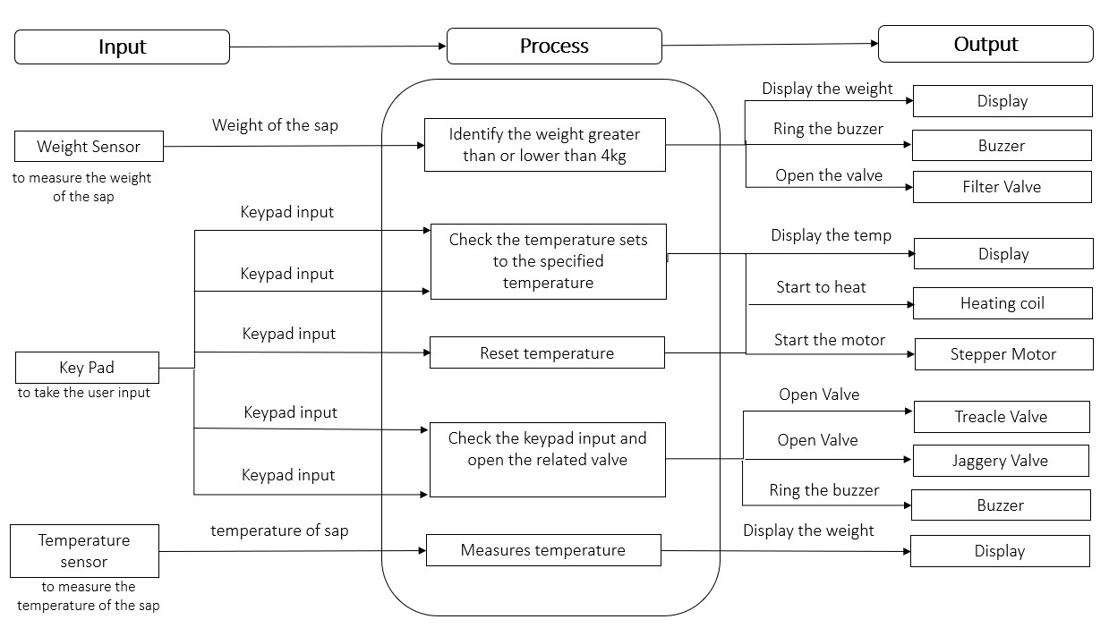
Proposed solution

Slide 9
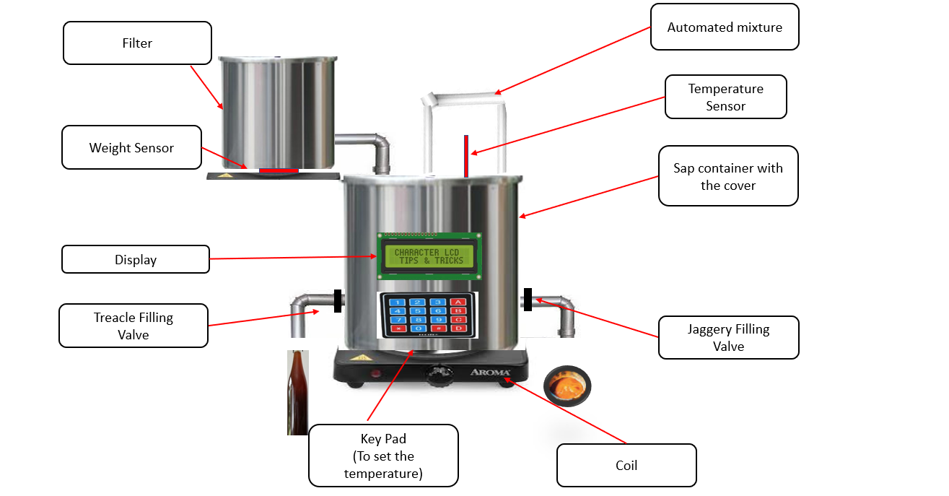
Design of the solution
Design of the solution
Filtering Valve
Buzzer

Slide 10
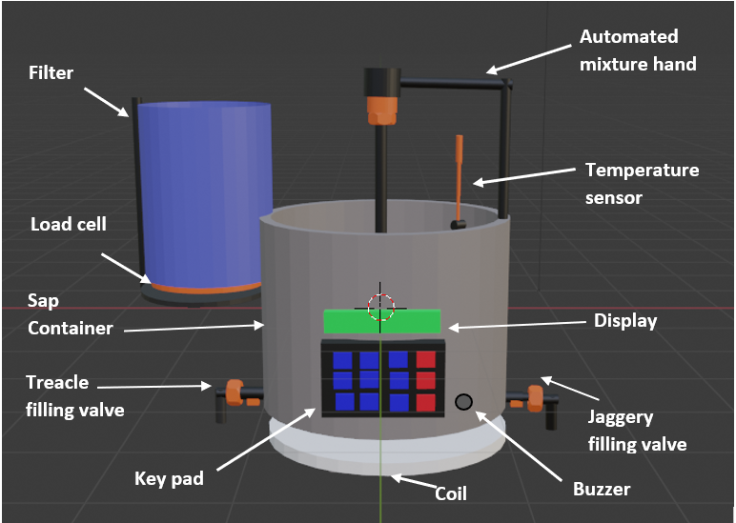
3d Design of the solution
Stepper Motor

Slide 11
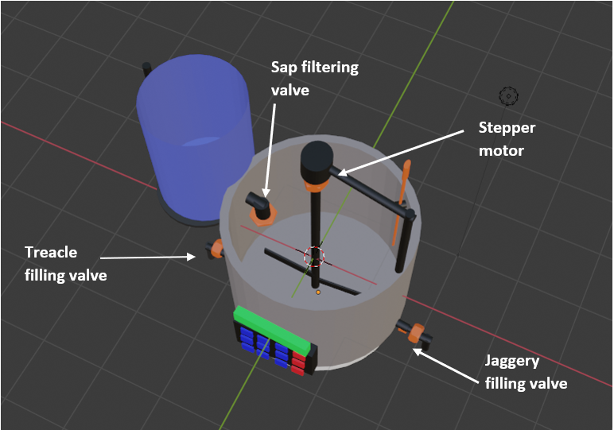
3d Design of the solution

Slide 12
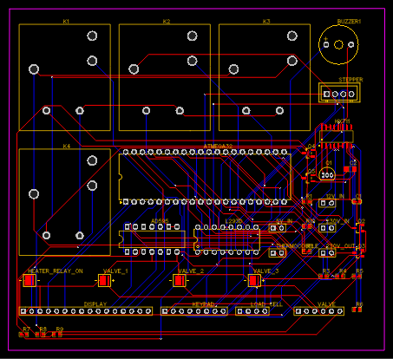
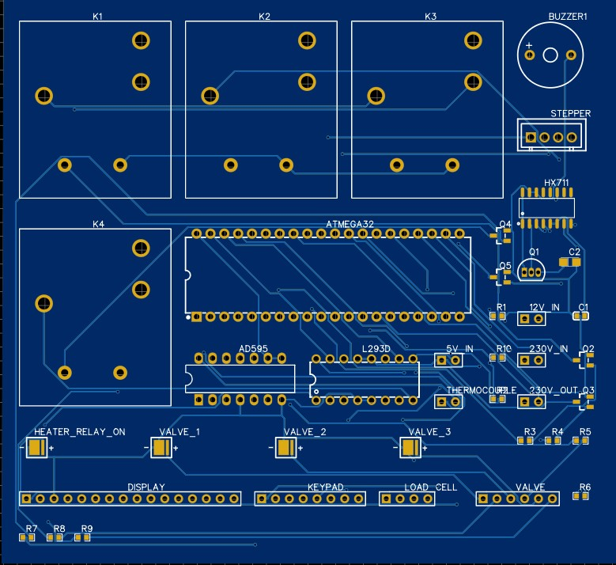
PCB Design

Slide 13
3d animation
https://dms.uom.lk/s/s9b9HfWnz3xsrfM

Slide 14
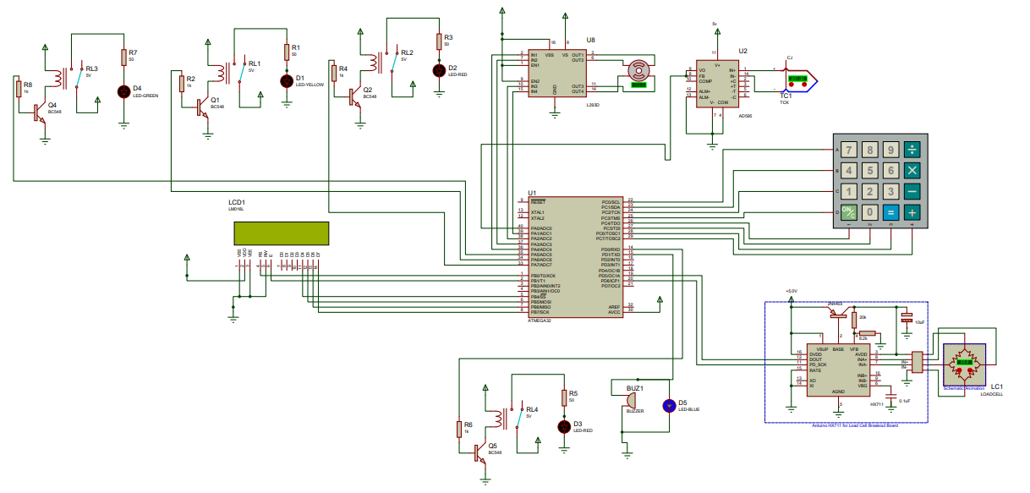
schematic diagram

Slide 15
Resources required
Hardware:
Weight Sensor(Load Cell)
Thermocouple
Stepper Motor
LCD Display
Buzzer
Atmega32 Microcontroller
Solenoid Valve
Keypad
HX711 Amplifier
Transformer
Capacitor
Rectifier
7812 power regulator
7805 power regulator
L293D Driver
Heating Coil
Software:
Atmel Studio
Proteus Software
Blender
PCB Layout

Slide 16
Cost of Components
Name | Quantity | Amount
Straight Bar Load Cell | 1 | 165.00
Hx711 Amplifier | 1 | 200.00
Thermocouple -TC10-0 | 1 | 700.00
Monolithic Thermocouple Amplifiers | 1 | 700.00
LCD Display 16*2 | 1 | 400.00
Piezoelectric Buzzer | 1 | 75.00
Solenoid Valves | 3 | 1500.00
Atmega 32 Microcontroller | 1 | 1010.00
NEMA 23 bipolar stepper motor | 1 | 1500.00
L293D Driver | 1 | 490.00
Heating coil | 1 | 2500.00
Keypad | 1 | 260.00
Heating Coil | 1 | 2500.00
Transformer | 1 | 1000.00
Cover | 1 | 2500.00
Other | 1 | 2000.00
Total 16800.00

Slide 17
Individual
Contribution

Slide 18
Individual Contribution
205050U
KAPUWATHTHA H.B.M.R.M.M

Slide 19
Responsibilities
Interfacing and coding Thermocouple
(Thermocouple type K -TC10-0)
Interfacing AD595 Amplifier
Interfacing and coding LCD Display
Designing 3D Design
PCB design of the thermocouple ,display and whole circuit
schematic diagram design of the thermocouple, display and whole circuit

Slide 20
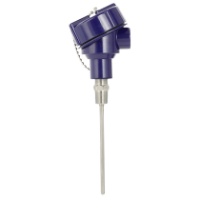
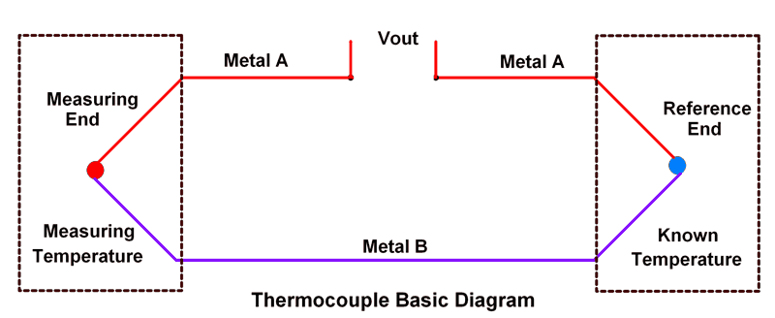
Thermocouple (Thermocouple type K -TC10-0)
Temperature range -40 to +1,260 °C
The thermocouple made by joining two dissimilar metals at one end
The joined end is referred to as hot junction and other end is called as cold junction.
The cold junction will also have certain temperature according to the Seebeck Effect.
The heat flows from the hot side to cold side, the temperature difference between these two junctions has created a small voltage and this voltage is used to measure the temperature
Maximum voltage = 40.44 µV/°C
Maximum current = 20mA

Slide 21
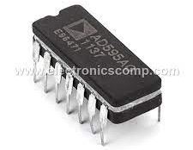
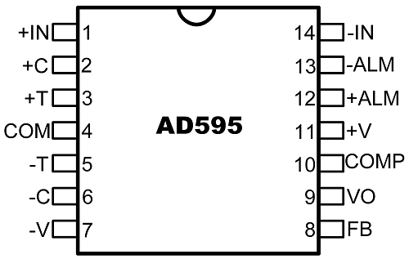
AD595 (Monolithic Thermocouple-Type k Amplifier)
AD595 is a complete instrumentation amplifier (Monolithic
Thermocouple Amplifiers) with a Cold Junction Compensation.
It combines ice point reference with the pre-calibrated amplifier to produce a high-level output (10mV/ºC) directly from the thermocouple output.
The output of a K-type thermocouple in this temperature range is 40.44uV/ºC and the final result is AD595 is 247.3 by 10mV/ºC divided by 40.44uV/ºC.
The input offset voltage for AD595 is 11uV
This offset arises because the AD594/ AD595 is trimmed for a 250mV output while applying a 25°C thermocouple input
AD595 Output = (Type K Voltage + 11 uV) x 247.3
Maximum voltage = 15V
Maximum current = 160 µA

Slide 22
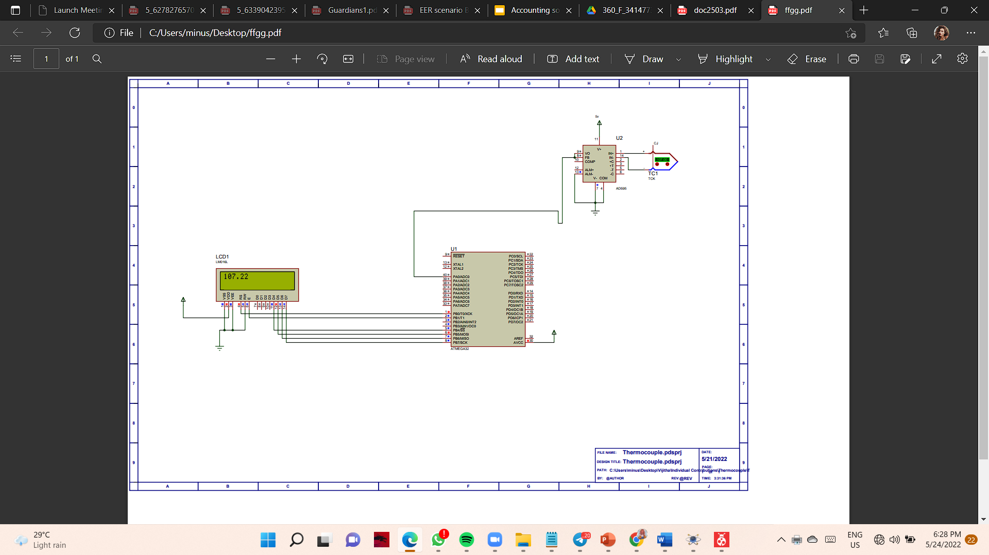
Schematic Diagram

Slide 23
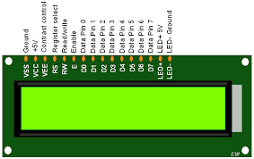
LCD Display
Display status or parameters in embedded systems.
has 2 lines with 16 characters
Each character is made up of a pixel matrix.
A 16-pin device
can be used in 4-bit mode or 8-bit mode
Can display user define characters, to print character symbols on LCD, we have to send ASCII code
The operating voltage is 4.7V to 5.3V
Current consumption is 1mA

Slide 24
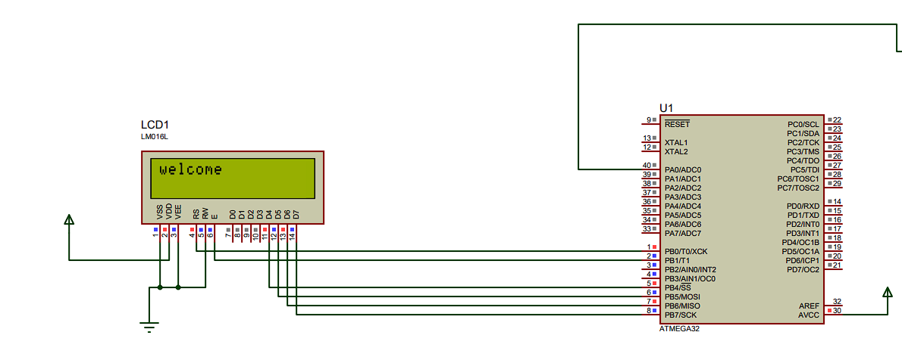
Schematic Diagram

Slide 25
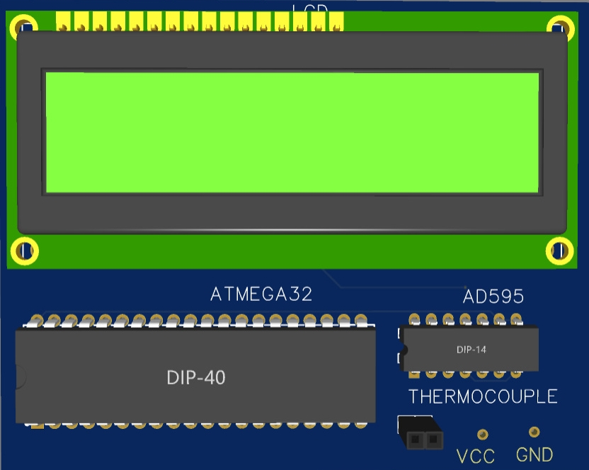
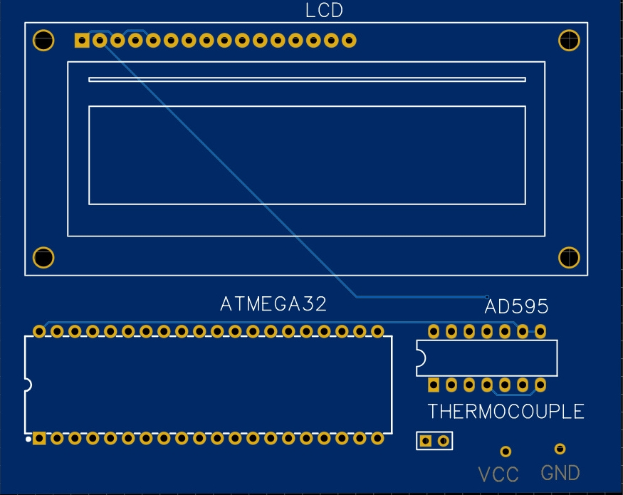
PCB DESIGN OF THERMOCOUPLE AND LCD DISPLAY

Slide 26
205093D
SALAMA F.H.F
Weight sensing
Power supply

Slide 27
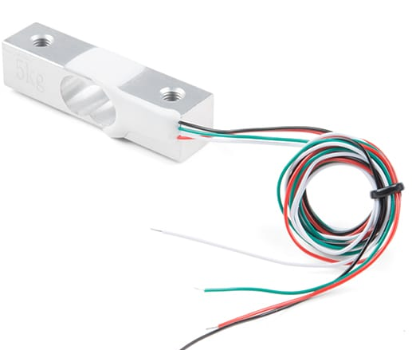
Load Cell
Load cell convert the load acting on them into electrical signals. The measuring is done with very small resistor patterns called strain gauges.
The electrical signal output by the load cell is very small and requires specialized amplification.
HX711 amplifier is used for amplification and measurement of the electrical output.
Maximum voltage = 10V
Maximum Current = 1mA
c

Slide 28
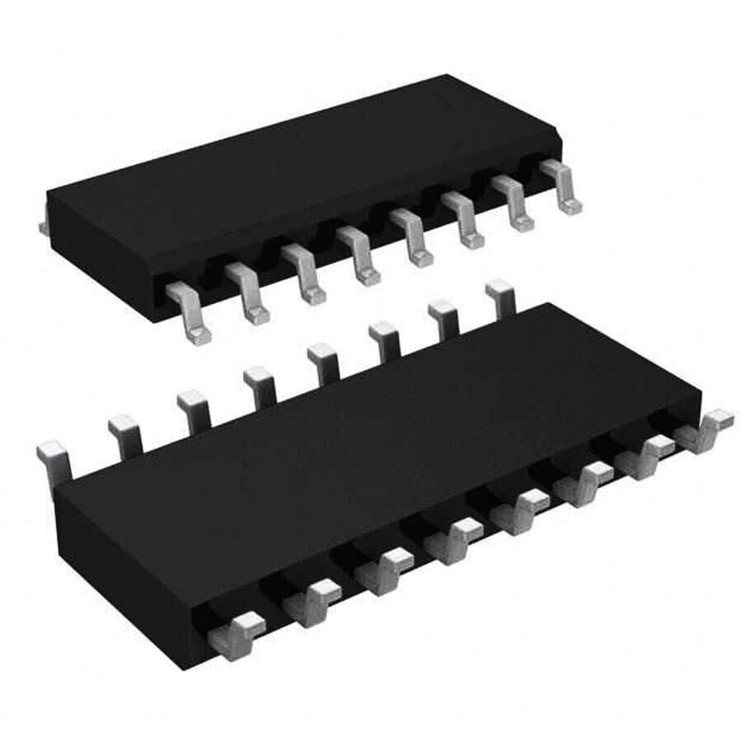
HX711 Amplifier
HX711 is a precision 24-bit analog-to-digital converter (ADC) designed for weigh scales to interface directly with a bridge sensor.
FEATURES
On-chip power supply regulator for load-cell and ADC analog power supply
On-chip oscillator requiring no external component with optional external crystal
On-chip power-on-reset
Normal operation < 1.5mA, power down < 1uA
Operation supply voltage range: 2.6 ~ 5.5V
Operation temperature range: -40 ~ +85℃
16 pin SOP-16 package
Maximum voltage = 5.5V
Maximum Current = 1.5mA

Slide 29
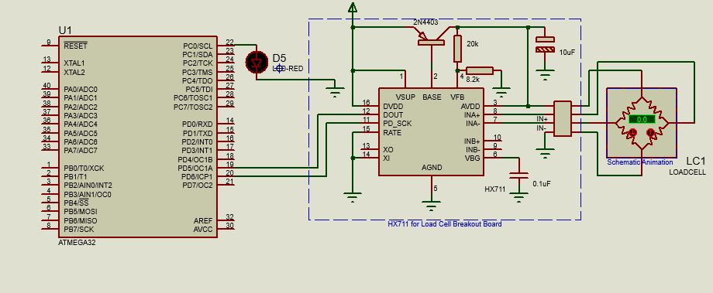
Weight Sensor Interfacing Proteus

Slide 30
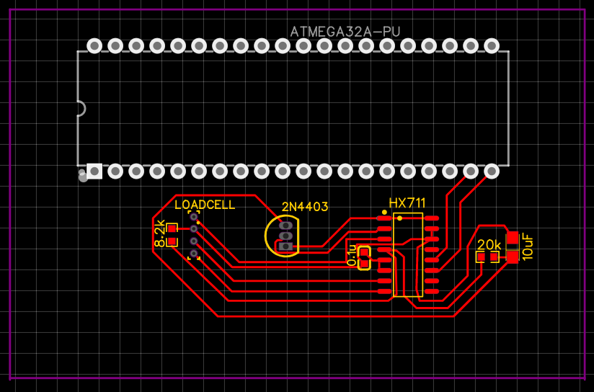
PCB Layout – Weight Sensor

Slide 31
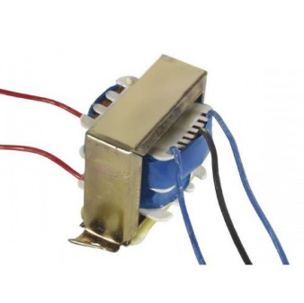
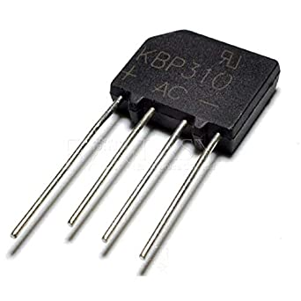
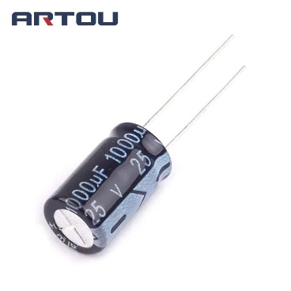
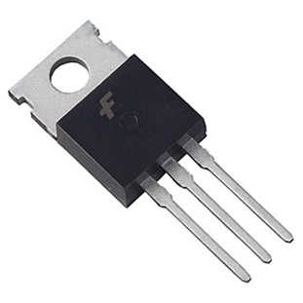
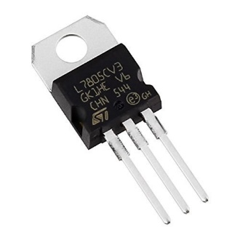
Power Supply Unit
12v-0-12v step down transformer
Bridge rectifier
1000uF Electrolytic capacitor
LM7812 voltage regulator
LM7805 voltage regulator

Slide 32
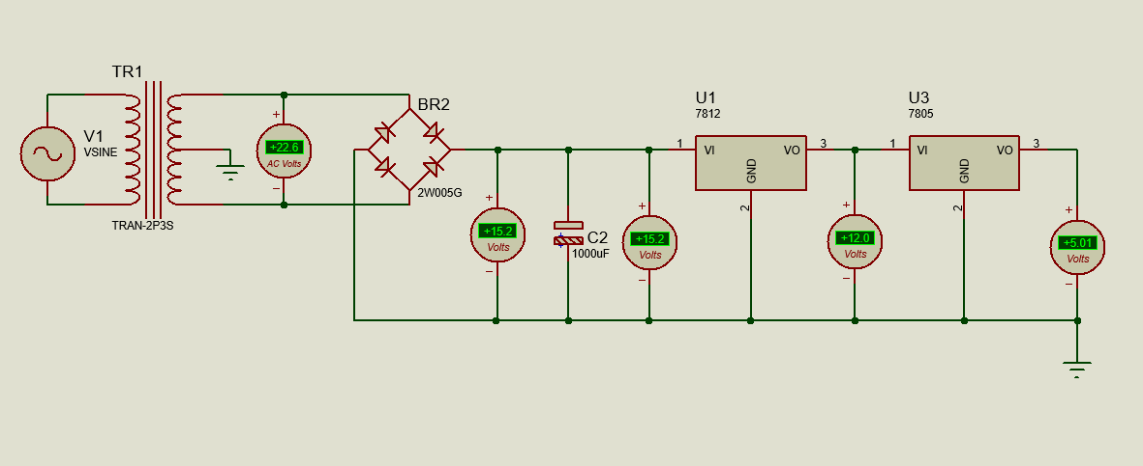
Power Supply Unit Interfacing Proteus

Slide 33
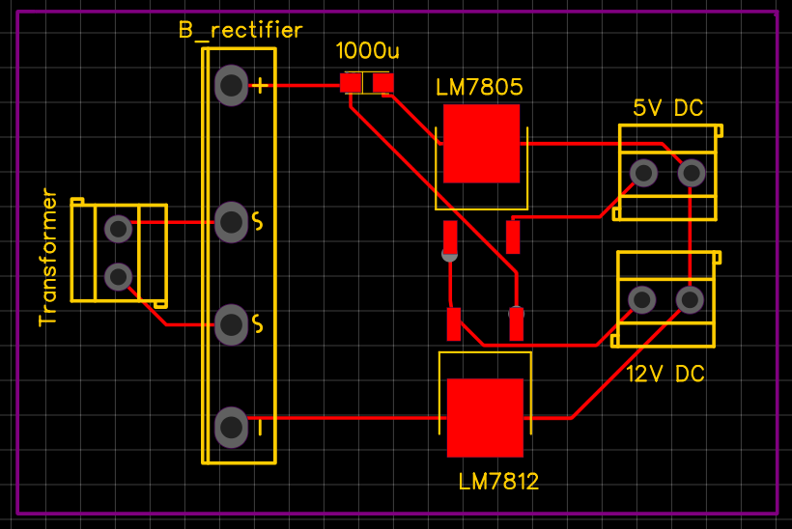
PCB Layout – Power Supply

Slide 34
205108G
Thennakoon T.M.M.S
Stepper Motor and Driver
Keypad

Slide 35
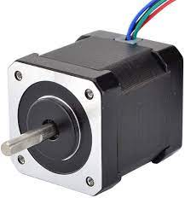
Stepper Motor
When the container is filled with sap, motor stars to rotate and it continues until the temperature set to set temperature.
When the user increases the set temperature after the process is done, motor starts again rotating until temperature set with the new set temperature.
c

Slide 36
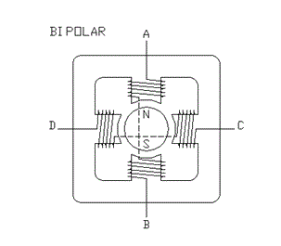
Bipolar Stepper Winding Arrangement
Manufacturer Part Number: 23HP22-2804S
Number Of Phase: 2
Step Angle: 1.8 deg
Holding Torque: 1.26 Nm(178.4oz.in)
Rated Current/phase: 2.8 A
Link to the Data sheet:
https://www.omc-stepperonline.com/download/23HS22-2804S.pdf

Slide 37
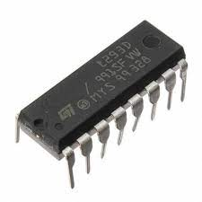
L293D driver
Specifications:
Type: Half Bridge
Operating Supply Voltage: 4.5 V to 36 V
Output Current :600 mA
Operating Supply Current: 2 mA
Minimum Operating Temperature: - 40 C
Maximum Operating Temperature: + 150 C
Unit Weight: 270 mg
Number of Outputs: 2 Output

Slide 38
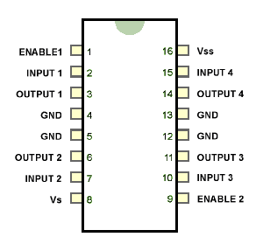
Pin diagram of L293D
Link to the Data sheet:
https://cdn-shop.adafruit.com/datasheets/l293d.pdf

Slide 39
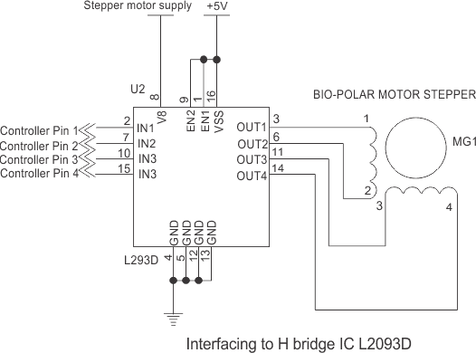
Interfacing L293D with Bipolar Stepper

Slide 40
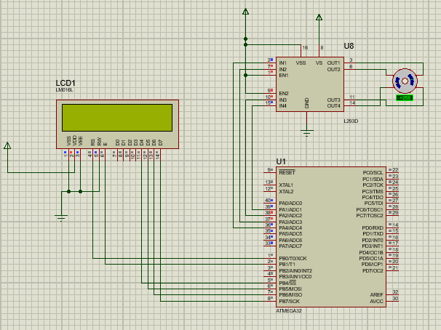
Stepper Motor And Driver interfacing Proteus

Slide 41
Code - Stepper Motor And Driver
#define F_CPU 8000000UL
#include <avr/io.h>
#include <util/delay.h>
void stepper();
int main(void)
{
DDRA = 0xFF;
PORTA = 0x00;
/* Replace with your application code */
stepper();
}
void stepper(){
//All pins of PORTC as output //Initially all pins as output high
while(1)
{
PORTA = 0b00010010;
_delay_ms(100);
PORTA = 0b00000110;
_delay_ms(100);
PORTA = 0b00001100;
_delay_ms(100);
PORTA = 0b00011000;
_delay_ms(100);
}
}

Slide 42

Keypad
Selecting options - makes the user go through the specific process. When the user selects an option, the system sets the defaults (temperature limit, valve no) for the specific product.
Increase the default set temperature to continue the process if the user is not satisfied with the output product.
Open/ Close valve

Slide 43
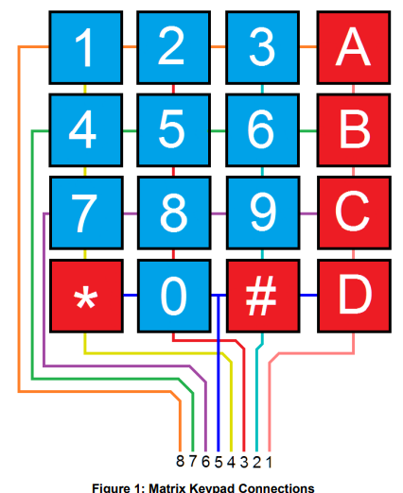
Keypad (Cont.)
Key Features:
Ultra-thin design & adhesive backing
Easy communication with any microcontroller
Cable included
Details:
Maximum Rating: 24 VDC, 30 mA
Interface: 8-pin access to 4×4 matrix
Dimensions: Keypad: 2.7 x 3.0 in (6.9 x 7.6 cm)
Cable: 0.78 x 3.5 in (2.0 x 8.8 cm)
Operating temp range: 32 to 122 °F (0 to 50 °C

Slide 44
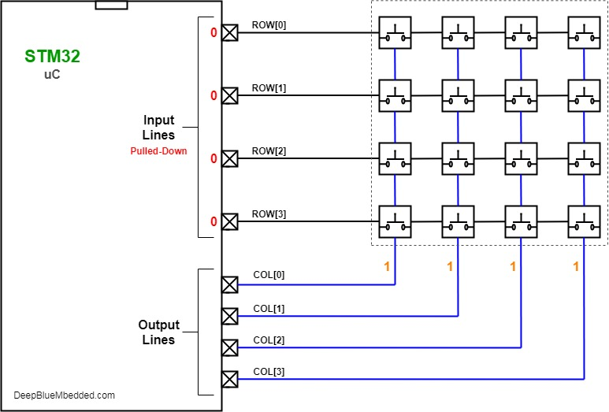
Interfacing Keypad
Link to datasheet-
http://www.electronicoscaldas.com/datasheet/Teclado-membrana-matricial-4x4.pdf

Slide 45
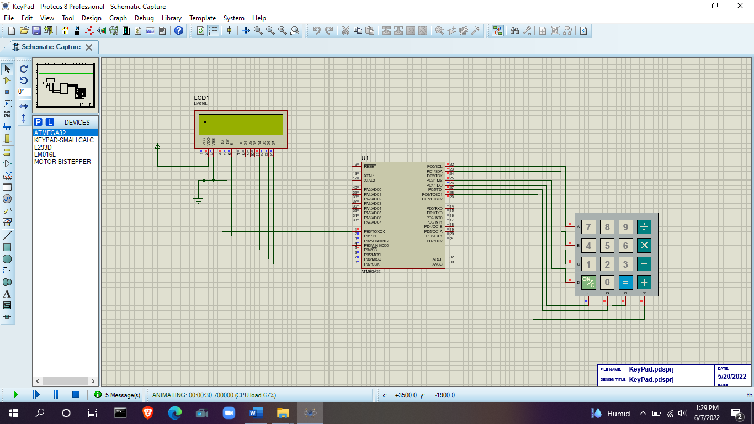
Keypad Interfacing Proteus

Slide 46
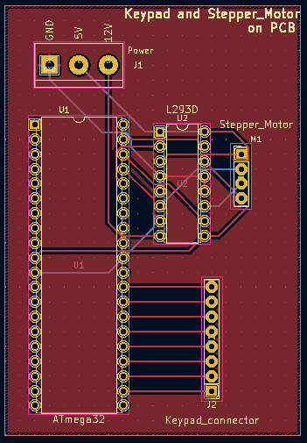
PCB Design

Slide 47
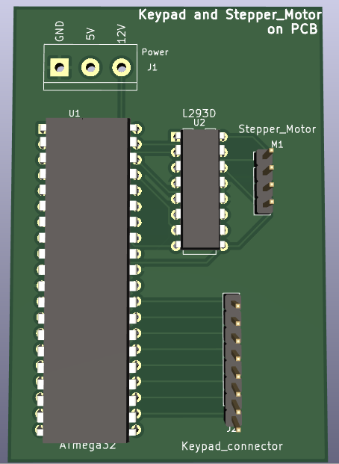
3D View

Slide 48
205096N
SAMARAKKODY S.A.T. S
Solenoid valve
Buzzer
Heater

Slide 49
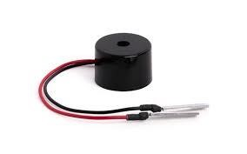
Buzzer
Use to give a signal/ message to user for specific purposes.
The buzzer activates, when
When the weight of the sap of Kithul Flower equals to 4kg
When the mixture turns to set temperature
The buzzer is placed in filtering part so that it can’t be affected from temperature
Piezoelectric Buzzer (Pin terminal type PS12 PS1240P02BT)
inexpensive yet reliable
can produce a variety of pleasant sounds,
and analog sound, intermittent sound
low power consumption.

Slide 50
Buzzer
Specifications:
Component | Piezoelectric Buzzer
Type | Pin terminal type PS12 (PS1240P02BT)
Rated Voltage | ~3 to ~250 V
Rated Current consumption | < 30 mA
Resonant frequencies | 2 to 6 kHz
Operating temperature range | –10 to +70°C
Sound pressure | 70dB(A)/10cm min
Pin Description | 2 pins (Power pin, Ground Pin)

Slide 51
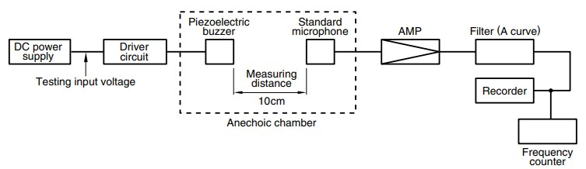
Piezoelectric components: convert electric energy into mechanical energy and mechanical energy into electric energy.
In short, the working principle of Piezoelectric Buzzer,
It works by applying an external voltage to the piezoelectric ceramic material.
That voltage takes as an input signal
Then piezo ceramic vibrate continuously and generates a pressure wave that the human ear can picks up as sound

Slide 52
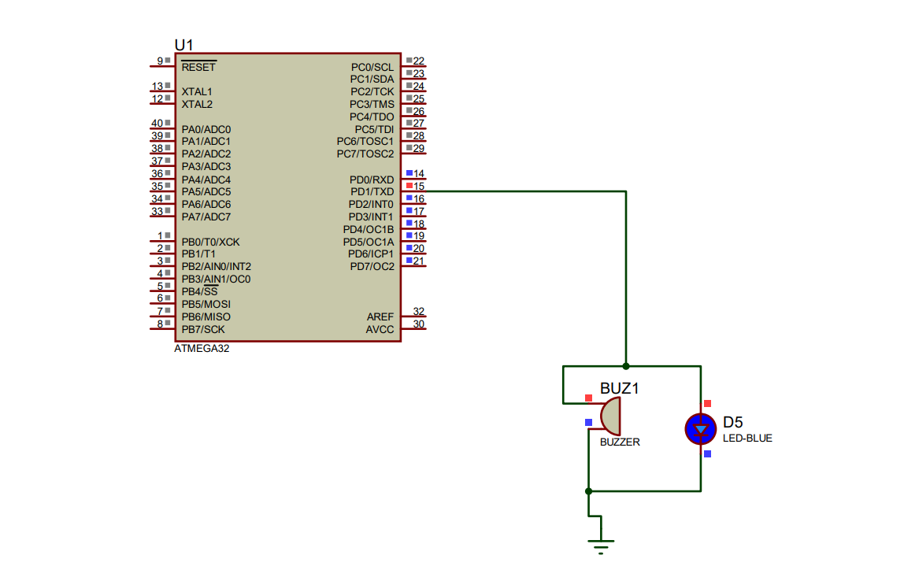
Buzzer schematic diagram

Slide 53
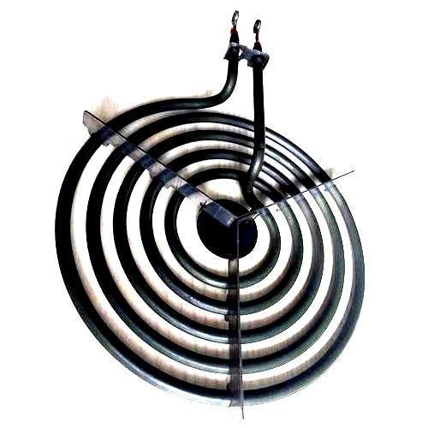
Heating Coil
The coil is made from ceramic or metal and heated through electric current.
It acts as a large resistor and as the electric current flows through it, it begins to heat up.
Heating coil is used to convert electric power into heat.
Electronic circuits include resistors, which control how much current flow. Even a thin piece of wire will get hot if you force enough electricity through it. In an incandescent lamp, there's a very thin coil of wire called a filament that glows white hot

Slide 54
Heating coil
Component | Heating Coil
Type | Round Coil Heater
Rated Voltage | 230 to 440 V
Power (Watts) | 50-10000W
Rated Current | ≤60mA
Frequency | 50, 60 Hz
Temperature | -5C - 350C

Slide 55
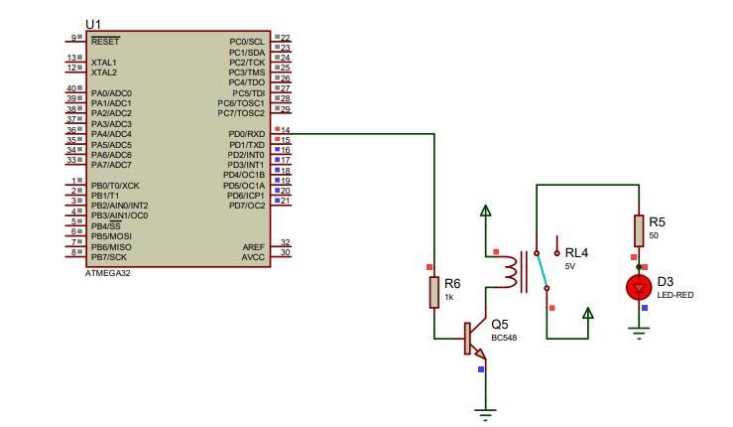
Heating coil schematic diagram

Slide 56
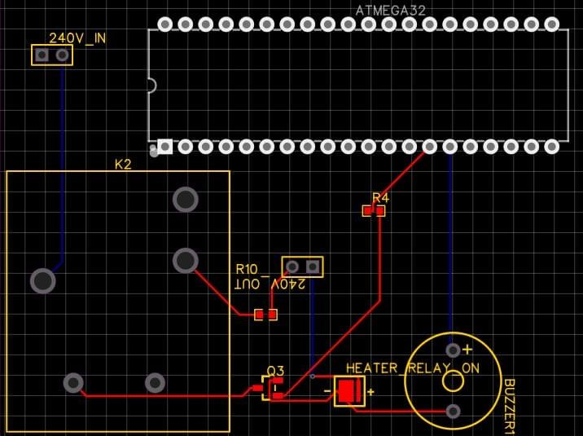
Pcb design for buzzer and heating coil

Slide 57
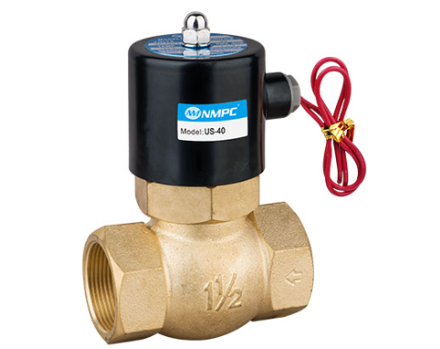
US Series High-Temperature Solenoid Valves
Valve 01: Filtering Valve
Purpose: to control sap filtering part to container
Valve 02: Treacle Valve
Purpose: to take out the Kithul Treacle from the container
Valve 01: Jaggery Valve
Purpose: to take out the Kithul Jaggery from the container
Features:
It adopts a Teflon hard seal structure
Reliable performance
high-temperature resistance
Large flow, high pressure,
good waterproofing performance
Multiple wiring directions

Slide 58
US Series High-Temperature Solenoid Valves
Component | Solenoid Valve
Type | US Series High-Temperature Solenoid Valves
Rated Voltage | 12V DC
Operating Voltage | 4 to 8V DC
Rated Current | ≤60mA
Pressure Range | 0.05 – 1.5 Mpa
Temperature | -5C - 350C

Slide 59
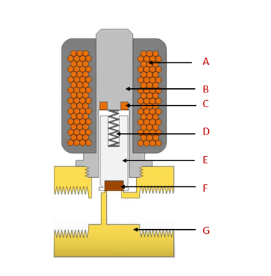
A: electromagnetically inductive coil, around an iron core at the centre called the
E: plunger
In the de-energized state,
a normally open valve is open
a normally closed valve is closed.
When current flows through the solenoid, the coil is energized and creates a magnetic field.
Then creates a magnetic attraction with the plunger, moving it, and overcoming the spring(D) force.
If the valve is normally closed, the plunger is lifted so that the seal(F) opens the orifice and allows the flow.
If the valve is normally open, the plunger moves downward so that the seal blocks the orifice and stops the flow.
The shading ring prevents(C) vibration and humming in AC coils.
A: Inductive coil
B: Armature
C: Shading ring
D: Spring
E: Plunger
F: Seal
G: Valve body

Slide 60
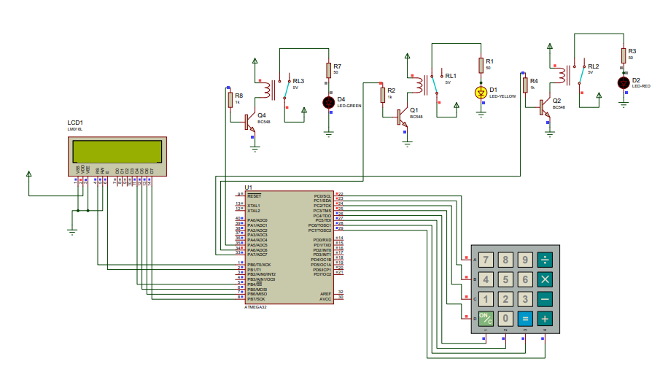
Solenoid Valves interfacing Proteus

Slide 61
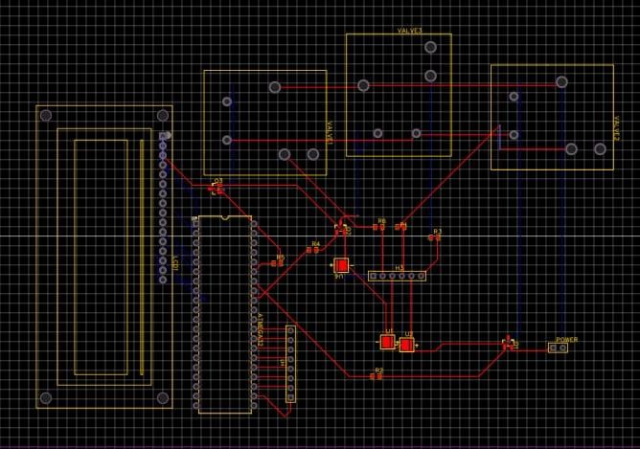
PCB Design of valves

Slide 62
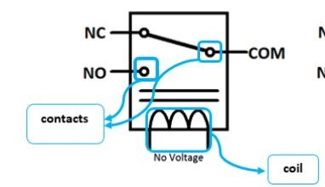
Relay Module
An electrical switch that operates electromagnet.
That electromagnet can be activated by giving a separate low-power signal from a microcontroller and when it is activated, the electromagnet pulls to either open or close another circuit.
Simply relays can control one electric circuit by using another circuit.
Pin diagram
normally open (NO)
normally closed (NO)
Common pin.
Apart from that coil pin is there.

Slide 63
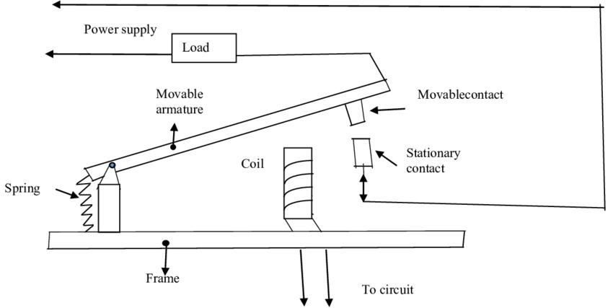
Relay module

Slide 64
Thank You

